Slide 1
CS3210 Tut 6 + Lab 6
Interconnects + Benchmarking
Slides misappropriated from Zhi Heng’s, inspired from Sriram

Slide 2
Revisiting Interconnects

Slide 3
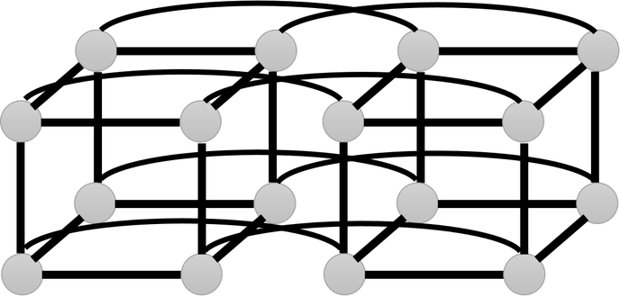
Why Interconnects?
Parallel computing ⇒ many separate processing elements (PEs)
These could be (non-exhaustive)
CPUs ⇔ Memory banks
CPU ⇔ CPU
Processor ⇔ Processor
Entire node ⇔ Entire node
We need to make an informed decision about how to connect them (as opposed to just YOLO it)

Slide 4
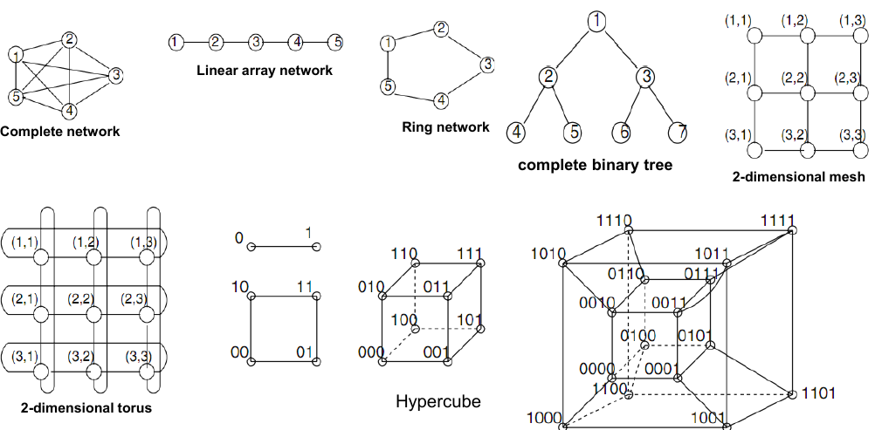
A litany of possibilities

Slide 5
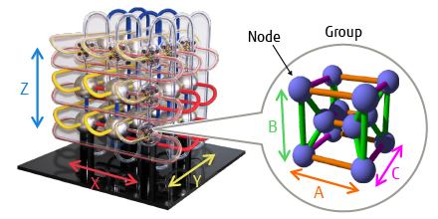

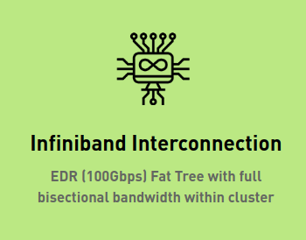
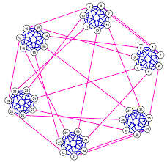
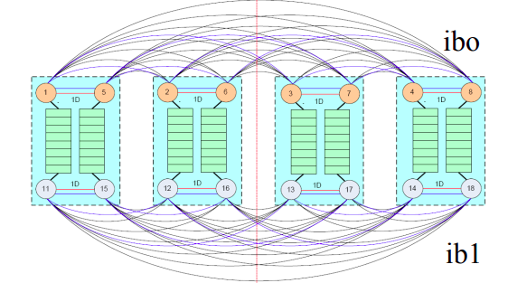
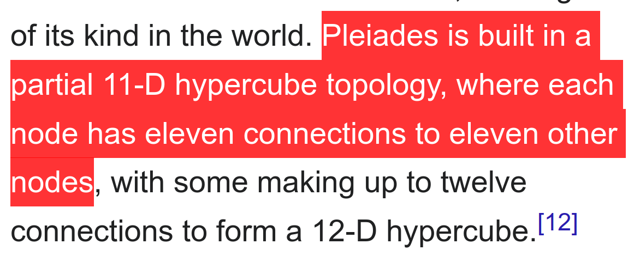
Real-world interconnects
Japanese Fukagu Supercomputer: 6D Torus (Tofu: "Torus Fusion")
Singapore NSCC: Fat Tree
Canadian Niagara Supercomputer:
Dragonfly Network
NASA Ames Pleiades: 11-D hypercube

Slide 6
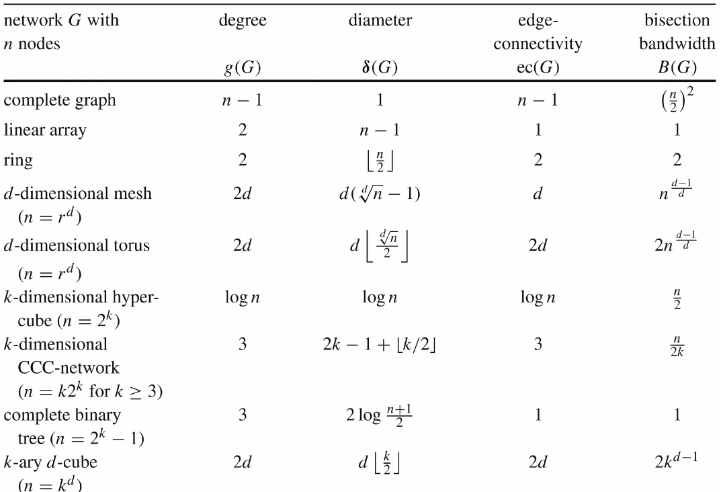
Golden Reference
Some notes:
Degree: maximum degree of a node (no. of links)
Diameter: “longest shortest path” that we can find between two nodes in the graph
Edge connectivity: how many edges to remove before network disconnects?
Bisection width: min edges to remove to split network in half

Slide 7
Q1

Slide 8
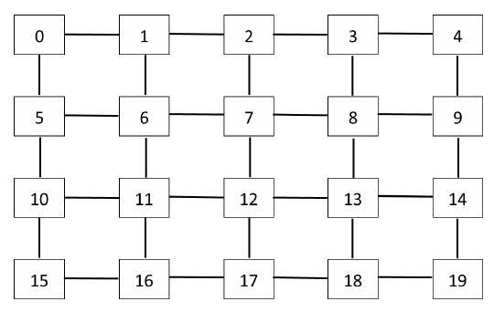
Q1: YX Routing
Here: messages move vertically to correct row, then horizontally
Each link can transfer 1 byte of data per clock
Node 0 sends 2 packets of 4 bytes each to Node 14
Node 11 sends 2 packets of 4 bytes each to Node 13
Important info: packets are not pipelined byte by byte
Send whole packet to next node first
Is there contention (queueing waiting for a link to be free?

Slide 9
Q1: YX Routing
Tracing the message from 0 → 14
T=0:
4 cycles for first packet 0 → 5
T=4:
4 cycles for first packet 5 → 10
T=8:
4 cycles for first packet 10 → 11
(snapshot at T=12)

Slide 10
Q1: YX Routing
What we know: First packet from 0 arrives at node 11 by T=12
Tracing the message from 11 → 13
T=0:
4 cycles for first packet 11 → 12
T=4:
4 cycles for second packet 11 → 12
11 → 12 link is free from T = 8 onwards!

Slide 11
Q1: YX Routing
For completion, continue tracing the message from 11 → 13
T=4:
4 cycles for first packet 12 → 13
T=8:
4 cycles for second packet 12 → 13
2nd packet from node 11 is received by 13 at T=12!
No contention!

Slide 12
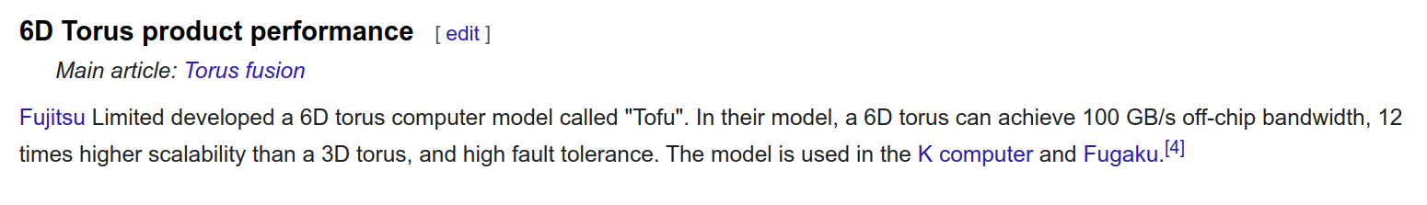
Why does this question matter?
Many, many supercomputers use Torus networks (mesh + edges are connected together)
This gives an idea of the resiliency and flexibility of such networks

Slide 13
Q2

Slide 14
Q2: Indirect Interconnects: Omega
You want to connect 8 processing units and 8 memory units
If Omega network: how many stages and switches per stage?

Slide 15
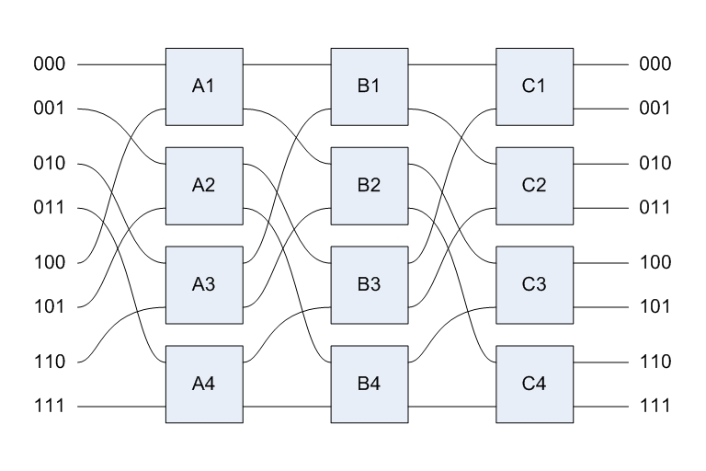
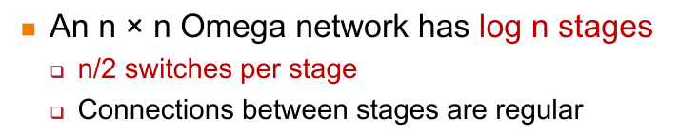
Q2: Indirect Interconnects: Omega
You want to connect 8 processing units and 8 memory units
If Omega network: how many stages and switches per stage?
log₂(8) stages = 3 stages
n/2 switches per stage = 8/2 = 4 switches per stage

Slide 16
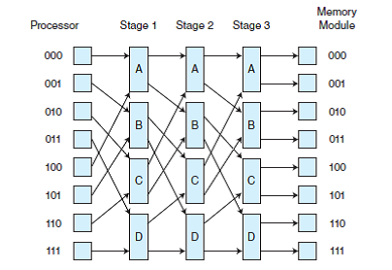
Why does this question matter?
Indirect interconnects have a lot of flexibility at the expense of cost (+ perhaps switching time)
Sometimes preferred for heterogeneous connections (e.g., CPU -> memory, etc)

Slide 17
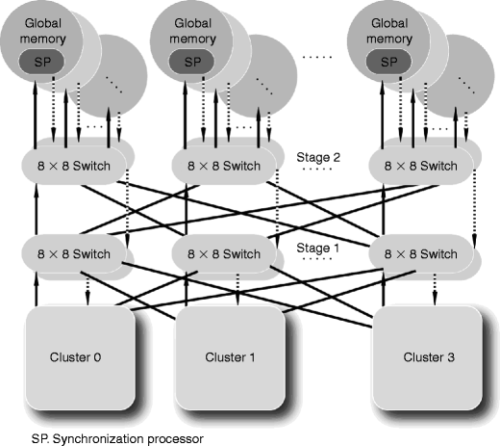
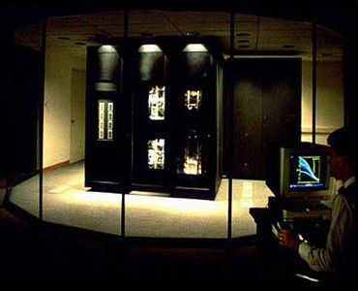
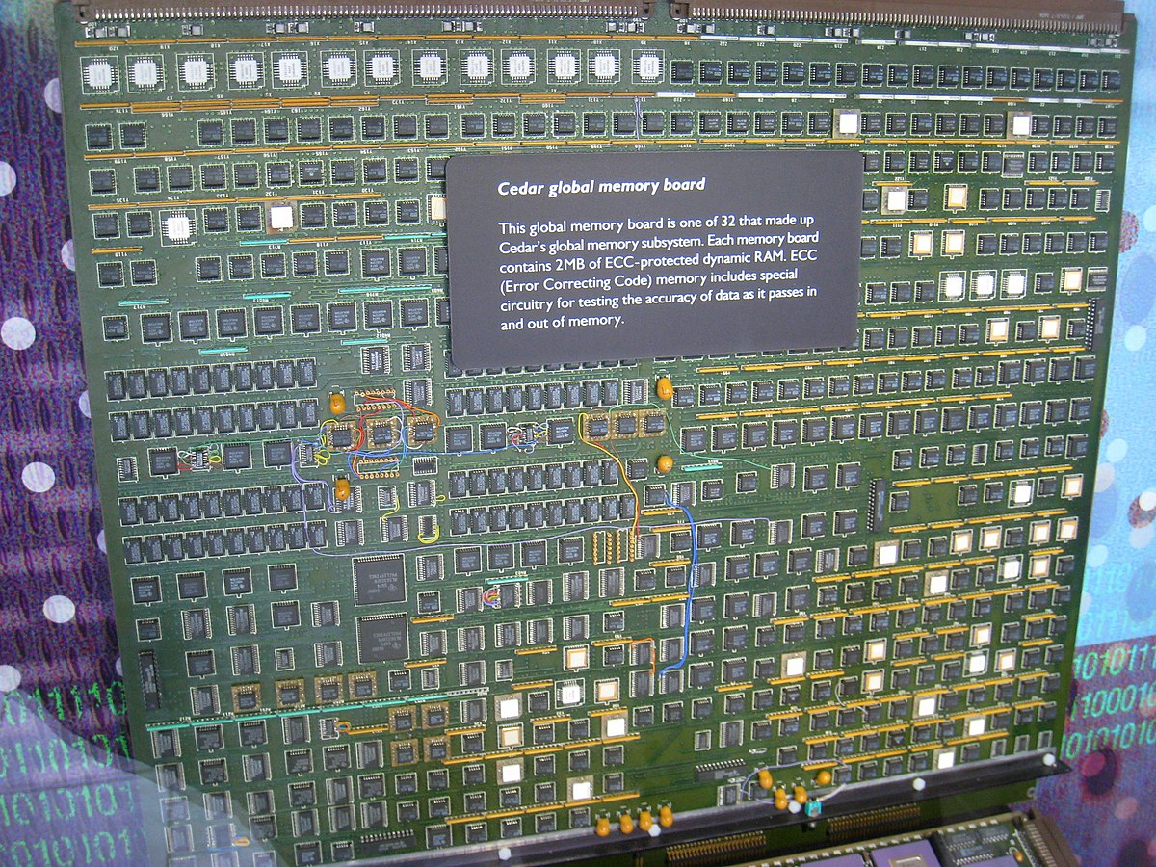
Examples
Illinois Cedar Multiprocessor
IBM RP3

Slide 18
Lab 6 (Optional)

Slide 19
Lab 6: Benchmarking
Won’t go into too much detail, but quick overview
Goal: Run Serial/OpenMP/MPI NASA benchmark on Slurm and compare performance
Alternative: Do the HPL benchmark, but very time-consuming! Do email Prof Cristina & Sriram if you want to attempt it.
Bonus 2% to get up to your 10% lab/tut grade (if fallen short somewhere)
Will finish Lab 4 marking by tomorrow, so you know if you need extra marks somewhere….
Submit by Saturday

Slide 20
Where to go from here
CS3210
????????

Slide 21
Where to go from here (Zhi Heng’s perspective + mine)
CS3230
STRONGLY RECOMMENDED as a prerequisite
CS5239
Deeper dive into theory of performance of computing systems
CS3210
CS4223
More hardware-focused than CS3210
(didn't take it as I unfortunately grad liao)
CS4231 ★
Learn theory of parallel algorithms
(Funny NUSMods reviews, still good to take) (took it because I thought I’m good at algos)
CS3211 ★
Learn how different programming languages implement parallelism (git gud at modern C++, Go and Rust)
CS5223
(ZH: If you want to torture yourself, Sem 2 only as YHF doesn’t entertain UG appeals)
CS4212
Compilers are cool :D
(Needs CS2104) (I live this module so much)
CS4215
Learn how different programming languages implement other stuff

Slide 22

End of Tut 6
Yipeee
Attendance

